Slide 1


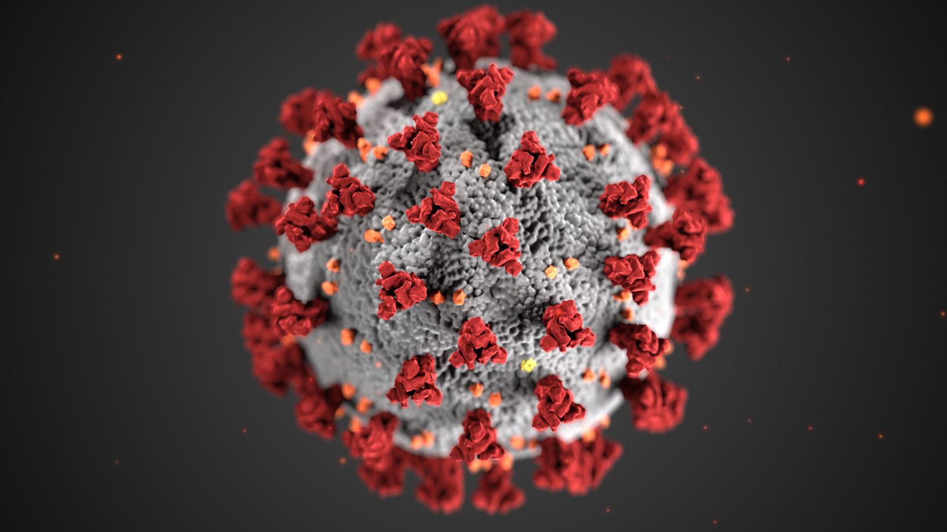

DE15 Report Presentation
George
Kate
Joao
Ross
Chris

Slide 2
Intent of our report
Impact of Covid on hospitalizations
Impact of Covid on demographics
General trend of consequent admissions
Representation in Shiny dashboard

Slide 3
Hospitalisations

Slide 4
Impact on Demographics

Slide 5
Map of Impact

Slide 6
Temporal data

Slide 7
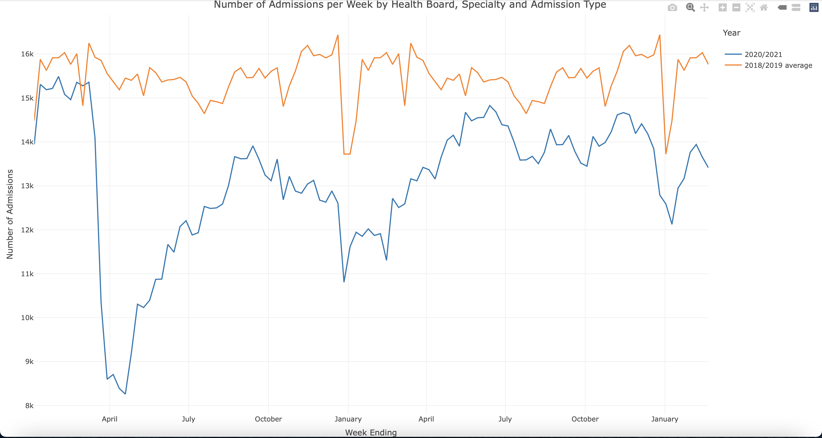
Trend of Admissions

Slide 8
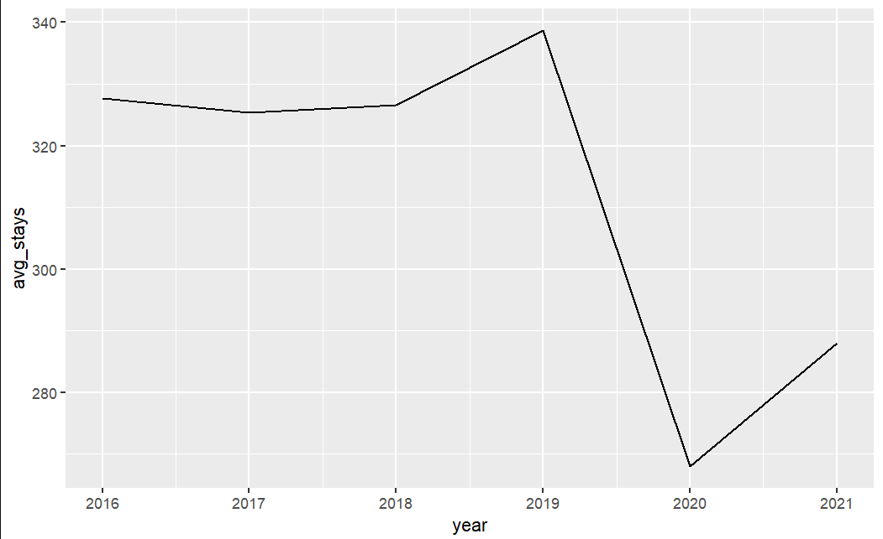
Trend of stays

Slide 9
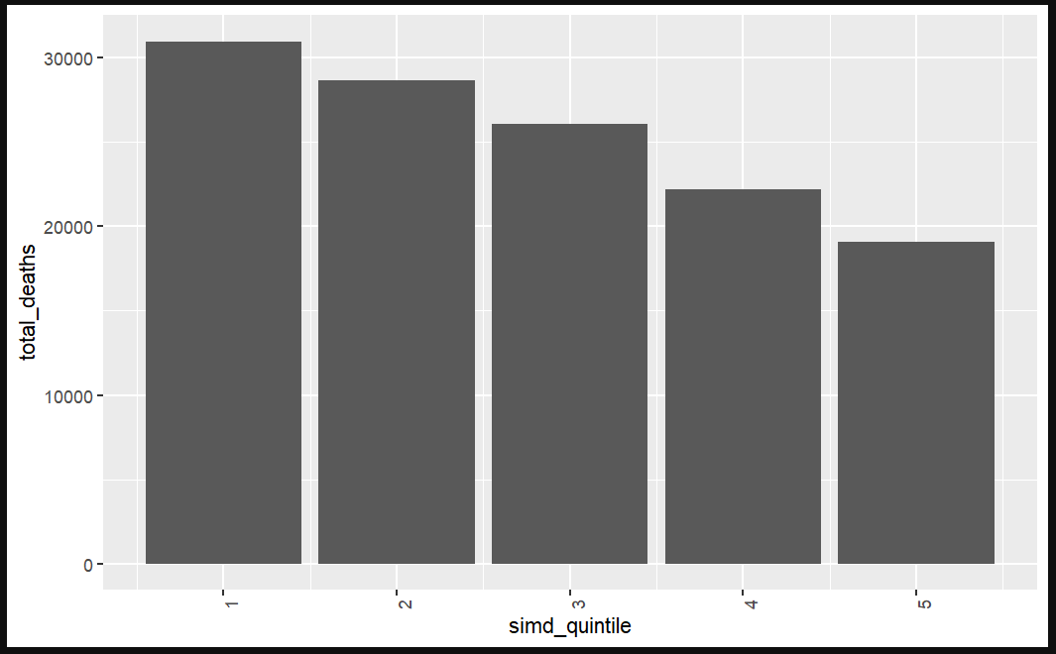
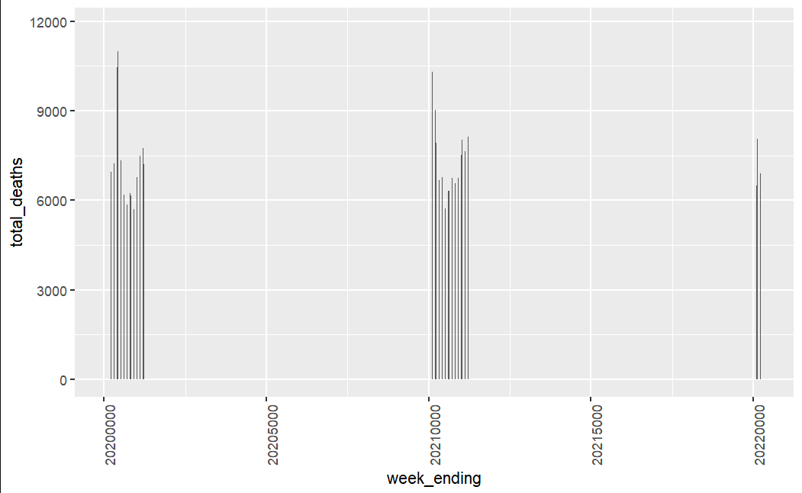
Trend of deaths

Slide 10
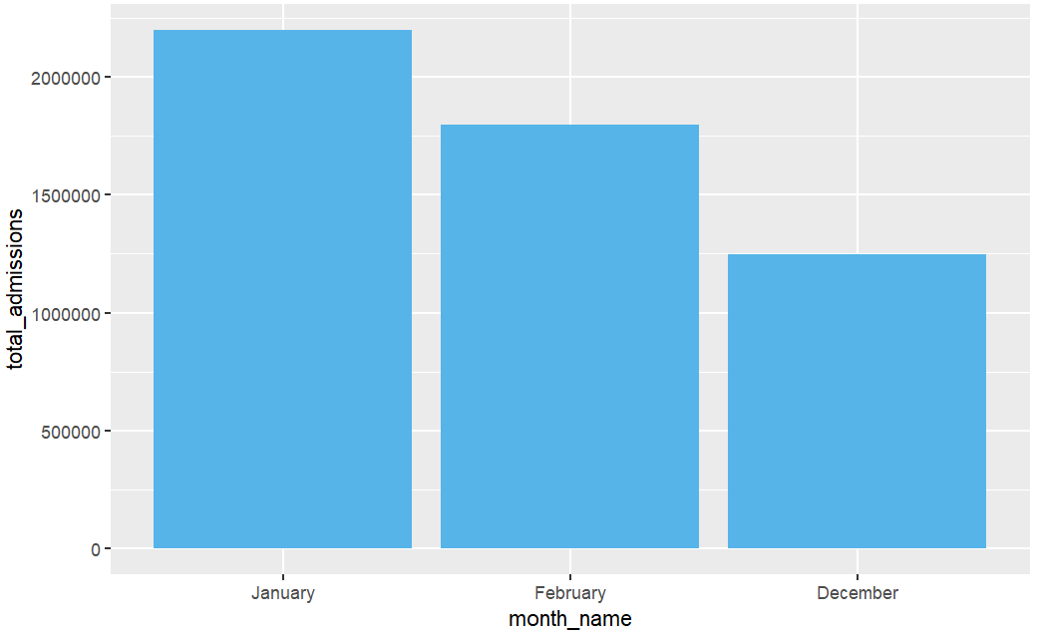
Impact of Winter

Slide 11
Conclusion
We are proposing that this 5% of the overall patients return home after their treatment each day as the other 95% of patients do, returning to the CIC for further treatment or assessment the next day

Slide 12
Shiny Dashboard

Slide 13
Current Range of Services 5 Consecutive Day Programme
Monday | 1800 | Heartmath Based Practice
Tuesday | 1000 | Mindful Movement
 | 1115 | Spiral of Chronic Health Issues
 | 1500 | Sleep Hygiene
 | 1800 | Heartmath Based Practice
Wednesday | 1000 | Mindful Movement / Breathwork
 | 1115 | Stress Talk
 | 1600 | Tai Chi / Heartmath Based Practice
 | 1800 | Nutrition
Thursday | 1000 | Mindful Movement / Breathwork
 | 1100 | Introduction to Exercise
 | 1515 | Art Therapy
 | 1800 | 23.5 Hour Day Video, Moving Forward /Heartmath
Friday | 1000 | Tai Chi / Heartmath Based Practice
All of these services are available on an outpatient basis

Slide 14
How many patients currently access overnight accommodation?

Slide 15
Multiple Consecutive Day Programme Activity
260 patients had 332 stays
181 patients (224 stays) were from NHS Greater Glasgow & Clyde patients
NHS Highland, Lothian and Lanarkshire have already restricted access to services, and new referrals are expected to reduce further

Slide 16
Overnight Stay Programme Activity in 2015/16
 | Episodes | Patients | Share
GGC | 224 | 181 | 69.7%
Lanarkshire | 50 | 36 | 13.8%
Ayrshire & Arran | 28 | 23 | 8.8%
Forth Valley | 14 | 10 | 3.9%
Highland | 7 | 5 | 1.9%
Lothian | 6 | 4 | 1.5%
Others | 3 | 1 | 0.4%
TOTAL | 332 | 260 | 100%

Slide 17
Where do our overnight stay patients come from?

Slide 18
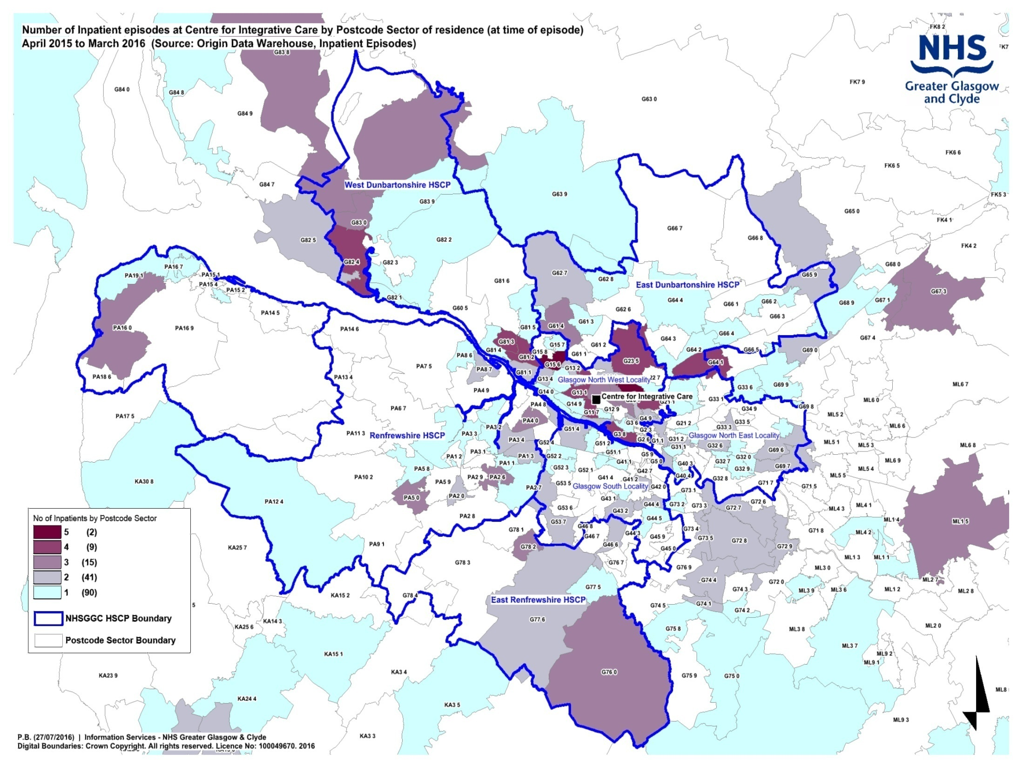

Slide 19
GGC residents in dark blue

Slide 20
Why are we changing? Scottish Government Health Department 2020 Vision (2011)
The Scottish Government’s vision for the NHS is that patients should only be admitted to hospital for urgent or acute care
People’s health should be managed in their own communities to allow them to remain in their own home

Slide 21
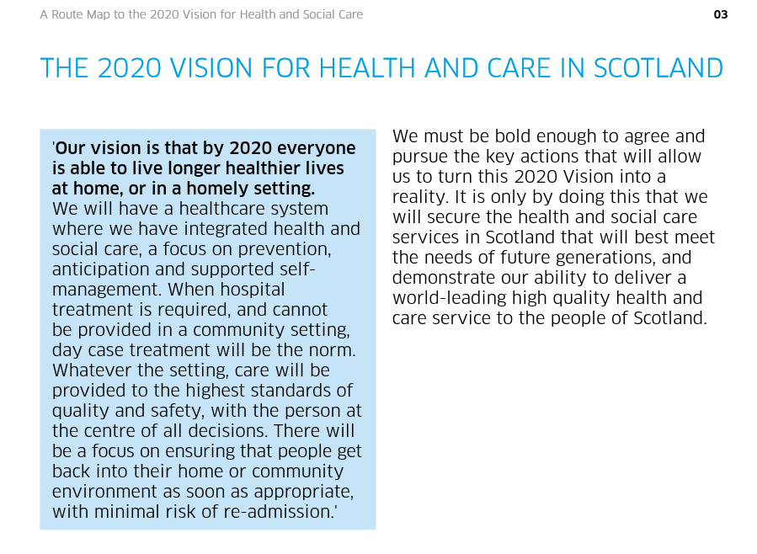
“When hospital treatment is required, and cannot be provided in a community setting, day case treatment will be the norm.”

Slide 22
The recent history of the CIC An ongoing process of change
Following the direction laid out in the 2020 Vision, along with the rest of planned care services across NHSGGC, the CIC has adapted to deliver more care on an outpatient or day case basis
The CIC has been on a redesign journey for a number of years, guided by the Scottish Government’s Long Term Conditions strategy
As part of this, it has already reduced from 15 inpatient beds, seven days a week, to 7 beds for overnight accommodation four nights a week

Slide 23
What do other Integrative Care Centres across the UK currently do?
There are two other large centres in the UK providing NHS Integrative Care services:
Royal London Hospital for Integrated Medicine
The Portland Centre for Integrative Medicine, Brighton
In both of these English Centres they have already fully transformed all their services to be delivered as outpatients or day treatment courses and have no inpatient beds

Slide 24
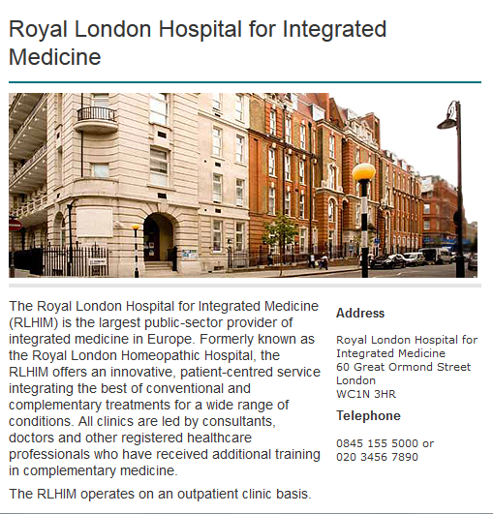

Slide 25
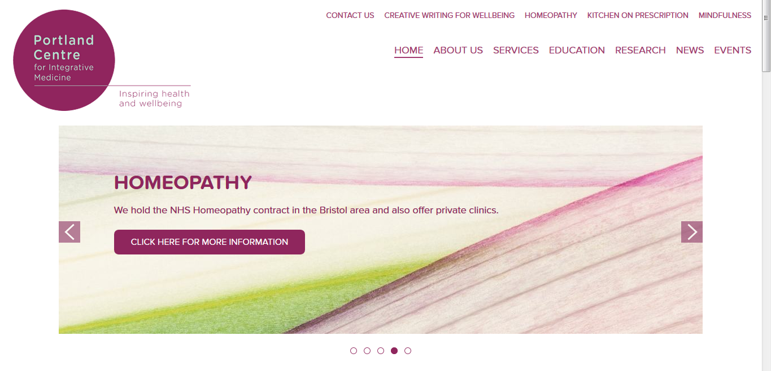
The Portland Centre is a private healthcare organisation
which delivers Health and Social care services under
contract to both NHS and local authorities
It has had no inpatient services since 2001.

Slide 26
Other NHS GGC Services
As well as bringing the CIC service delivery into line with the other UK centres
This change would align the clinical model within CIC to those delivered in other services
At the adjacent Beatson West of Scotland Cancer Centre, chemotherapy and radiotherapy are delivered as five day programmes on a day case basis

Slide 27
GGC residents treated at Beatson West of Scotland Cancer Centre

Slide 28
Other services
Treatment programmes for most long-term conditions in GGC are now delivered in an entirely outpatient and day case basis:
Dermatology
Neurology, inc Multiple Sclerosis, Parkinson’s and Movement Disorders
Chronic Pain Management Programme

Slide 29
Feedback
What are your thoughts so far?
Do you have any comments?

Slide 30
Informing and Engaging
Deliver an engagement programme with people across the area which will run from September to December 2016
Programme shaped by a Stakeholder Reference Group representative of patient, carer and public affected by proposal to assist with the development of a range of communications resources and advise on the best means of engaging with those affected

Slide 31
Engagement Plan (Discussion)

Slide 32
Next steps

